Slide 1
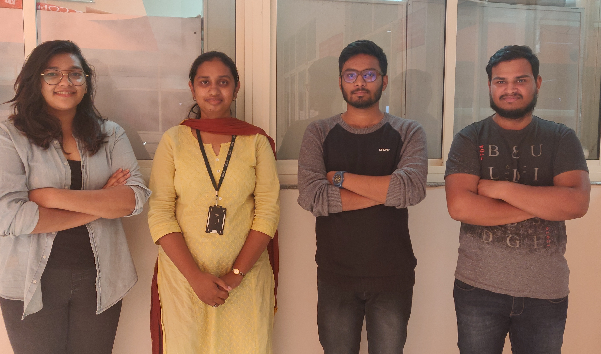
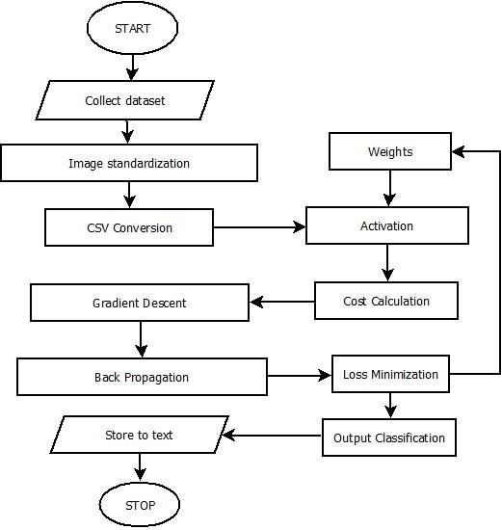
Faculty of
Management and Commerce
Department of Computer Sciences and Engineering
PYTHON LIBRARY FOR ENGLISH CHARACTER RECOGNITION
In the field of Artificial Intelligence, scientists have made many enhancements that helped a lot in the development of millions of smart devices. They brought a revolutionary change in the field of image processing where one of the biggest challenges was to identify documents in both printed as well as hand-written formats. One of the most widely used techniques for the validity of these types of documents is `Character Recognition'. Character Recognition can be used to store the document is well ordered form with clarity of writing and it also saves space and search time. In the presented model, we will be handling the issue of machine reading English alphabetical figures. We have tried developing such a model that corresponds to the ability of human beings to identify such characters. The objective is to make a system that can classify a given input correctly into the corresponding character class. In today's world, just the development of any model isn't the end of the task, the real task lies is making the model efficient, keeping that in mind we have made the model into a library which can be imported and used by anyone easily.
Ms. Pallavi R Kumar
Ashish Kumar 16ETCS002144
Satyam Agrawal 16ETCS002115
Sarah Anwar 16ETCS002114
Saurav Kumar 16ETCS002161

